Slide 1
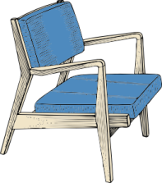
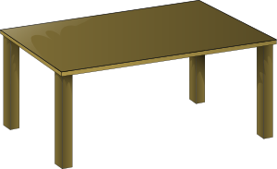
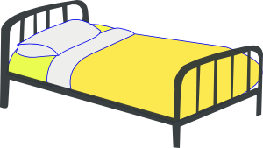
Apple | Pear | Banana | Grape
Cricket | Football | Rugby | Tennis
Maths | English | Science | History
Chair | Table | Bed | Sofa

Slide 2
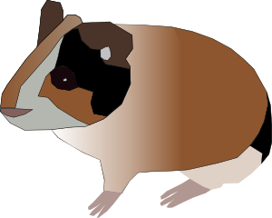
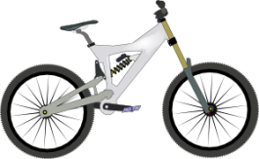
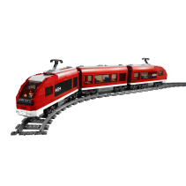
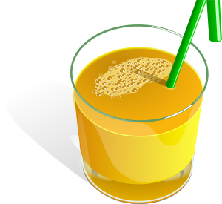
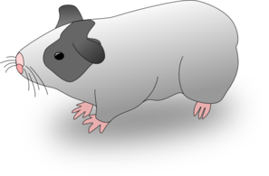
Dog | Cat | Goldfish | Hamster
Car | Plane | Bicycle | Train
Hot Chocolate | Cola | water | Orange Squash
Tea | Pineapple | Guinea Pig | Basketball

